Slide 1
Artifact Removal
By: Steven Cao

Slide 2
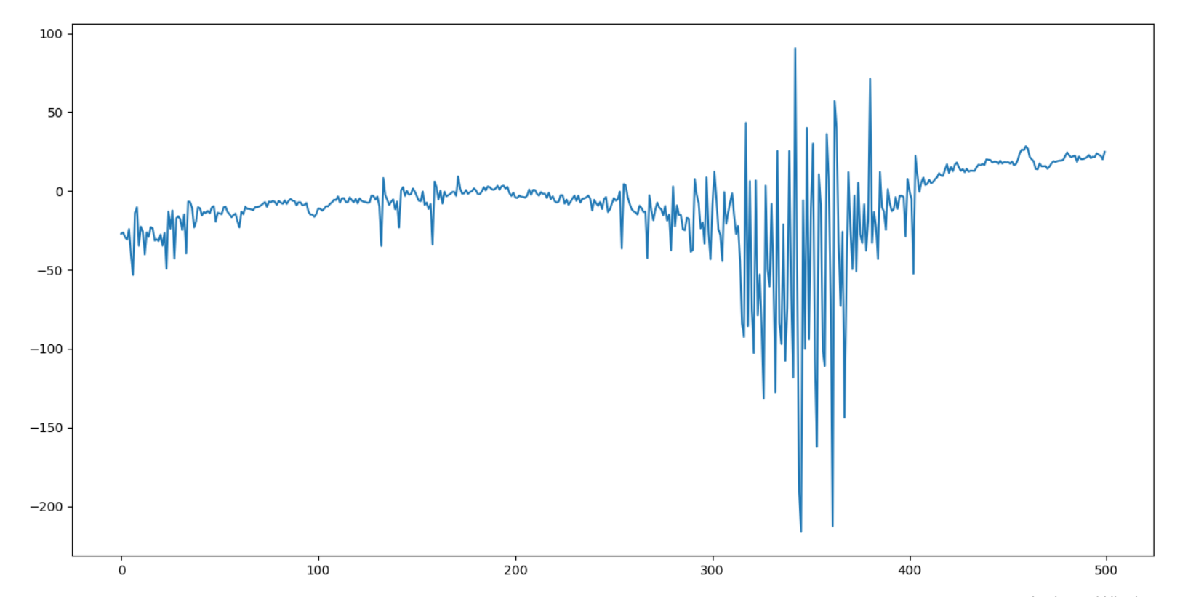
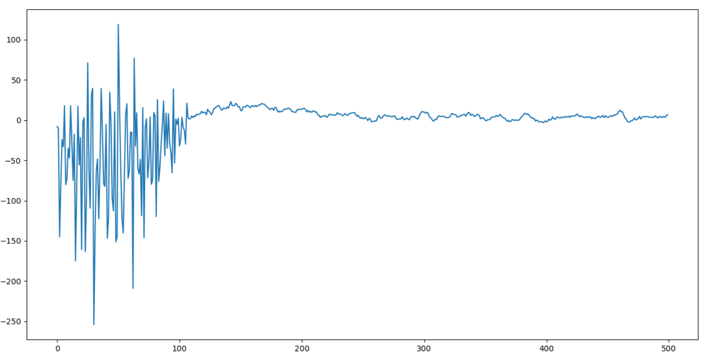
What is an artifact in EEG?
Definition
Artifacts are signals recorded by EEG but not generated by brain
Examples that may cause artifacts
Movements
Arm moving
When the electrodes are detached from the scalp
Electrodes not fully connected to the person
Sweating produces electrical disturbances by short-circuiting electrode pairs
Causes abnormal connections between two nodes of the circuit current as impurities in the sweat can cause the electricity to flow erratically
Subject#8: Epoch #11
Subject#8: Epoch #57

Slide 3
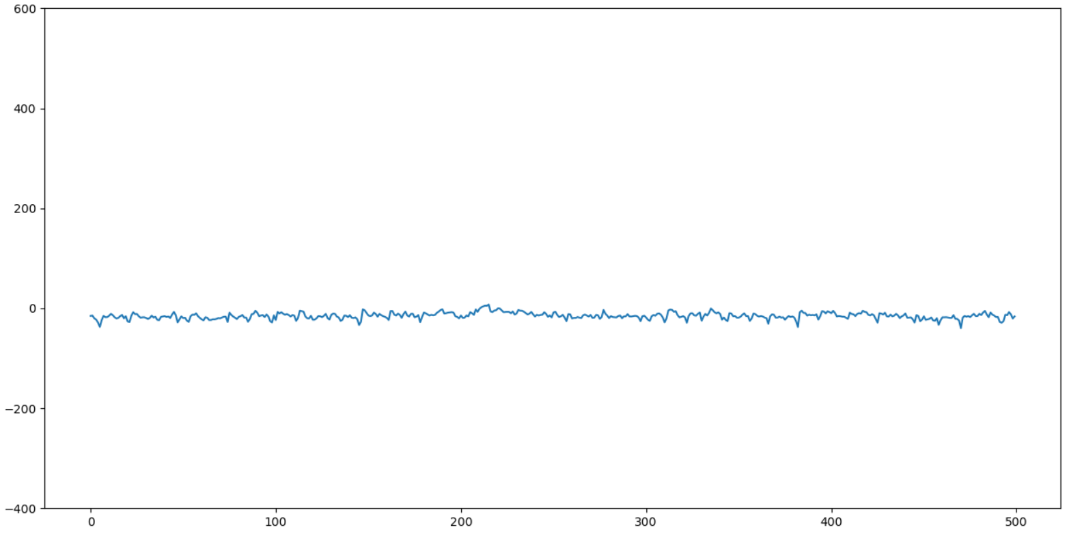
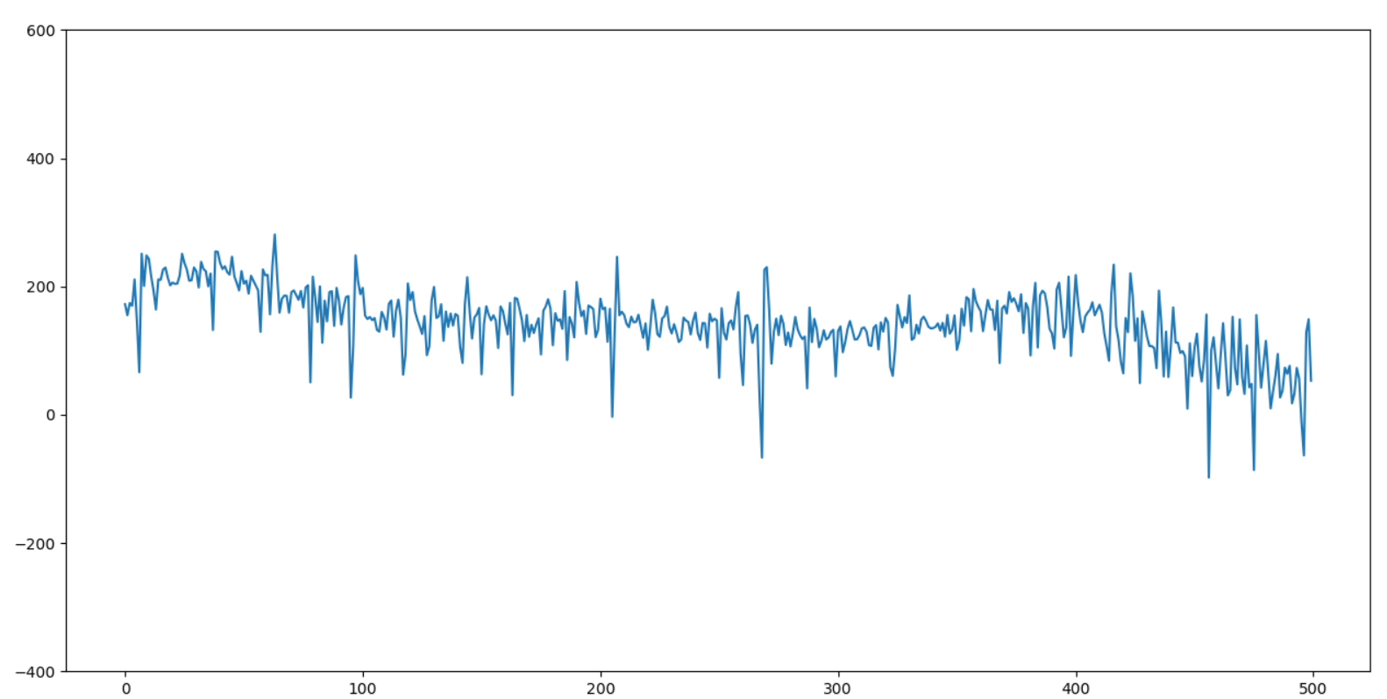
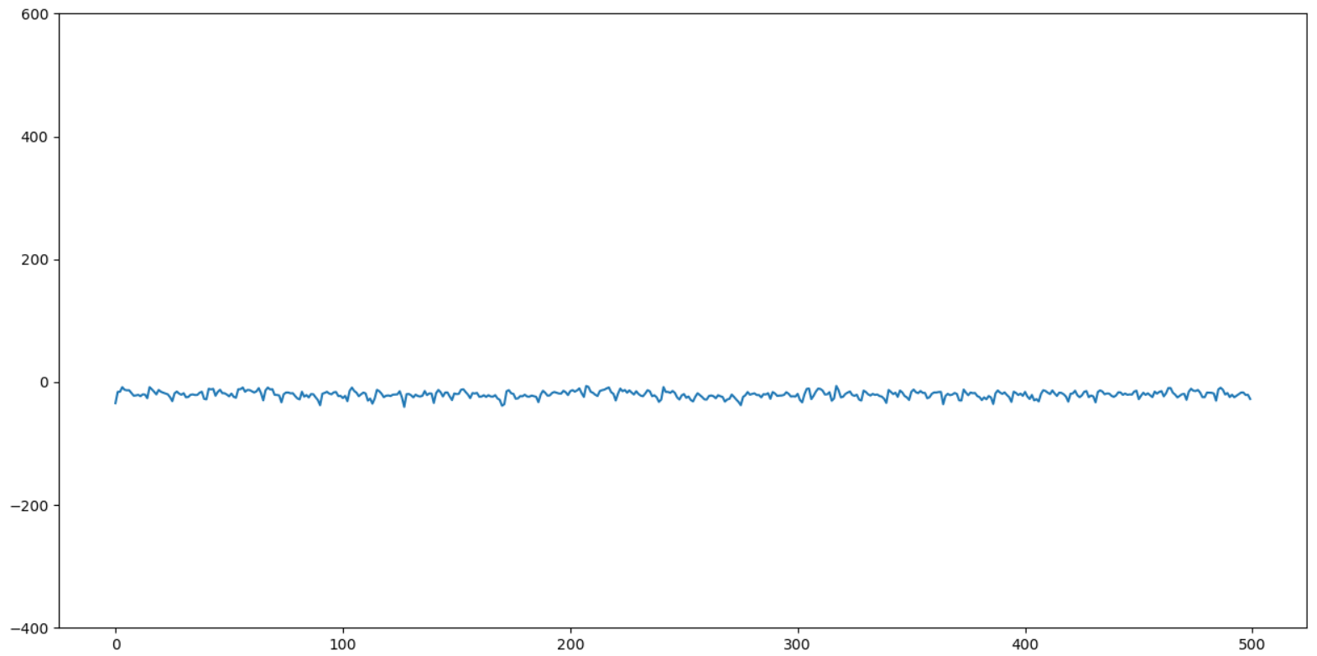
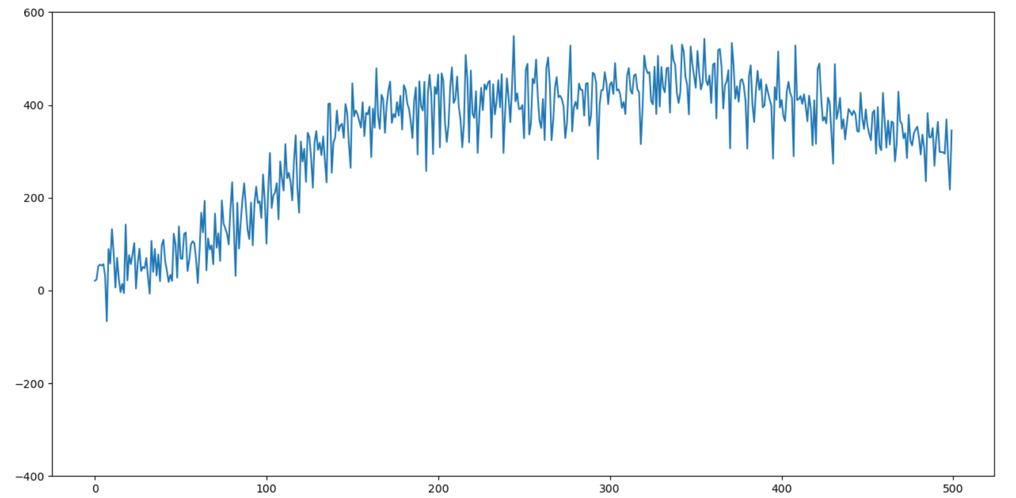
Non-Artifacts vs. Artifacts
Good signals Bad signals
Notes:
1: subject#7: Epoch #22 (good)
2: subject#7: Epoch #100 (good)
3: subject#7: Epoch #470 (bad)
4: subject#7: Epoch #471 (bad)

Slide 4
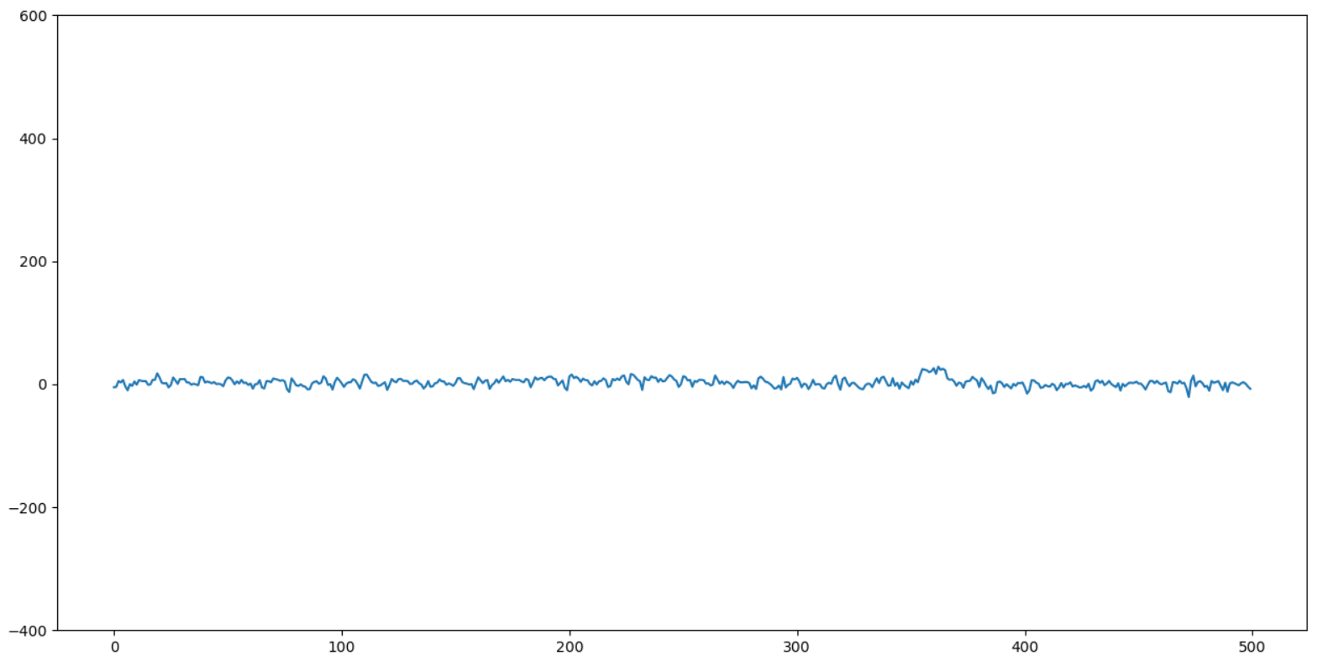
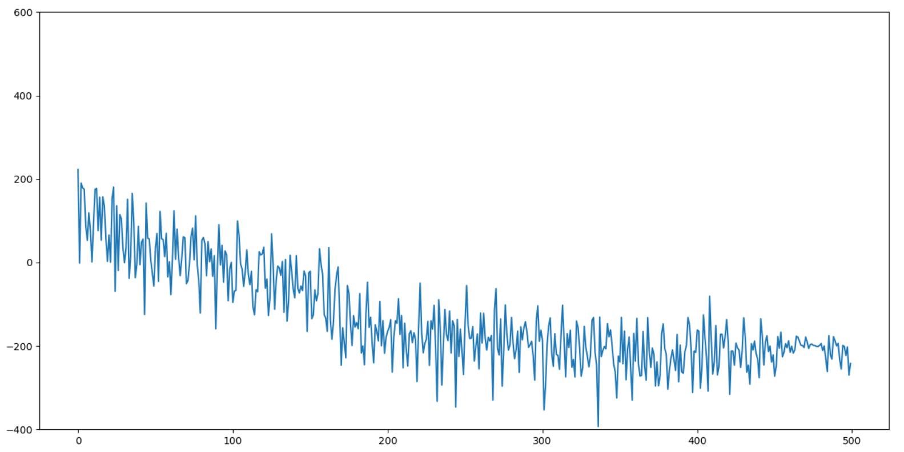
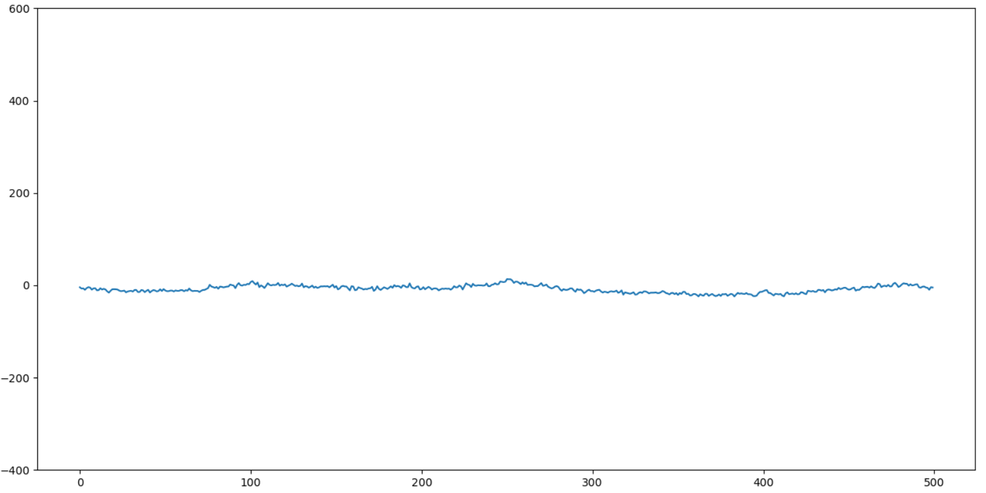
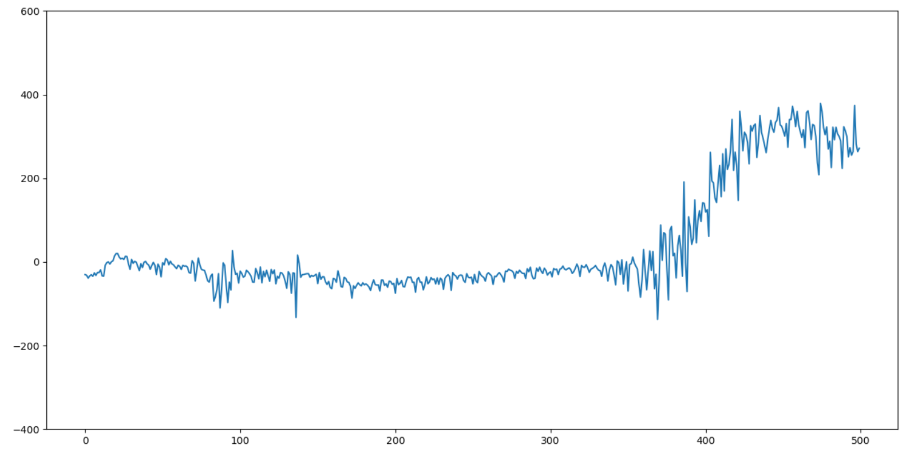
Non-Artifacts vs. Artifacts
Good signals Bad signals
Notes:
1: subject#7: Epoch #704 (good)
2: subject#7: Epoch #1455 (good)
3: subject#7: Epoch #2652 (bad)
4: subject#7: Epoch #2266 (bad)

Slide 5
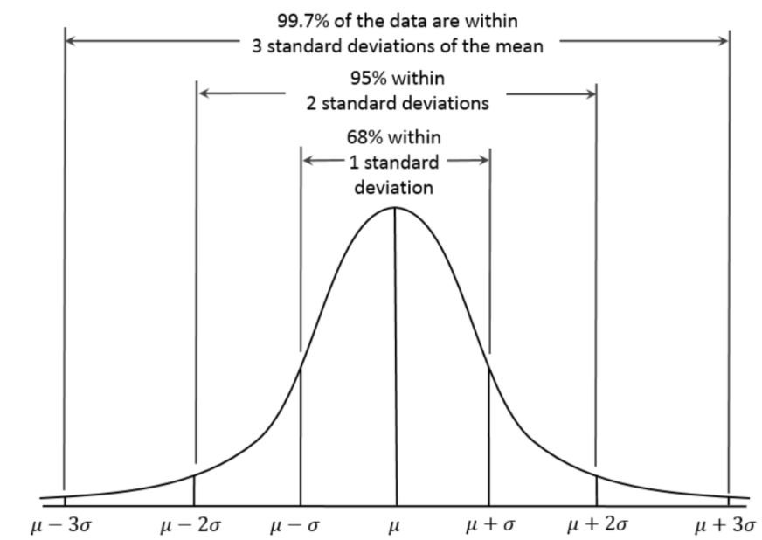
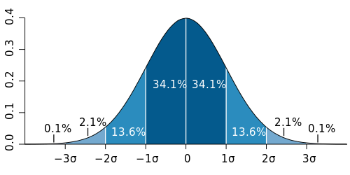
Core Concept: Central Limit Theorem
Definition
If you have a population with mean μ and standard deviation σ and take sufficiently large random samples from the population with replacement, then the distribution of sample means approaches a normal distribution.
Mean of this normal curve is equal to the mean of the population.
Standard deviation of a distribution of samples is equal to the standard deviation of the population divided by the square root of the sample size.
Why is it important?
We can use the mean’s normal distributions for any statistical tests that uses sample means.
Confidence intervals
T-tests (difference between the means of two samples)

Slide 6
Central Limit Theorem
the distribution of std of any epoch is a Normal distribution.
there are many factor determining the EEG signals, the distribution of sample approaches a normal distribution.
Explain this curve using your words in compact way
Using that, the probability of any value that is more than 3 standard deviations from the mean is less than 0.3%, which is very rare.
Based on that, any value that is more than 3 standard deviations from the mean is an artifact.

Slide 7
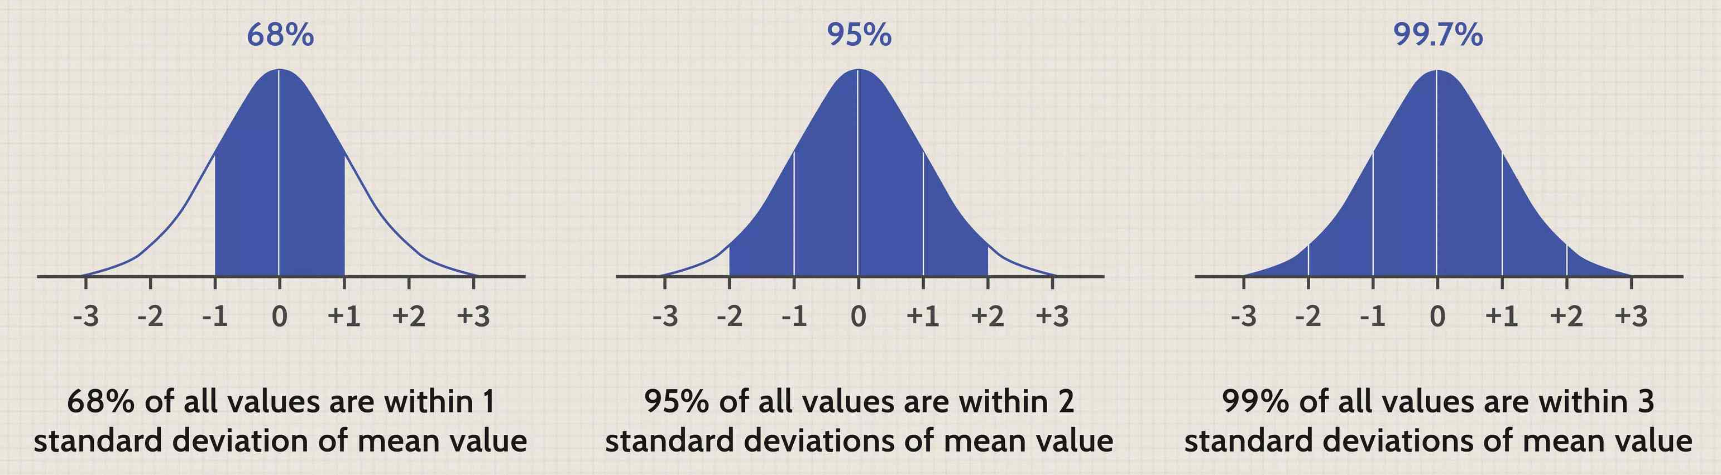
How I use it in artifact removal?
Central limit thorem can estimate the probability of samples taking on values that vastly deviate from the population mean.
Using that, the probability of any value that is more than 3 standard deviations from the mean is less than 0.3%, which is very rare.
Based on that, any value that is more than 3 standard deviations from the mean is an artifact.

Slide 8
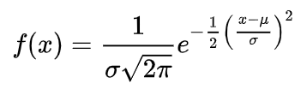
How I use the 3 std rule in artifact removal
Explain using your words
normal distribution:
two parameter: mean, std of (epoch std)

Slide 9
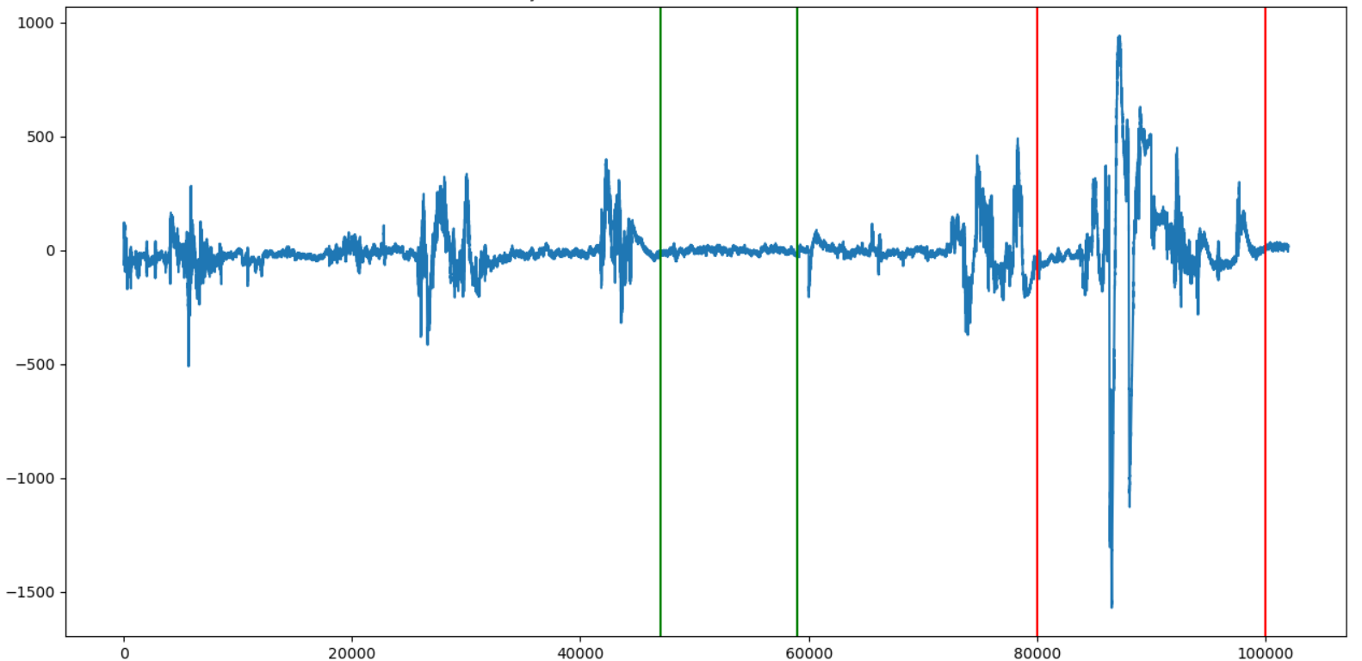
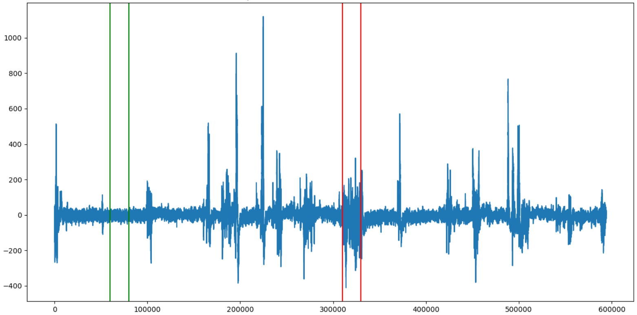
Step 1: Manually getting good epoch indexes
For each subject, plot its data and manually get the indexes of a good segment of data
Green lines refer to the indexes of the good segment for this subject
Green lines refer to the indexes of the good segment for this subject
Dataset#1 : Subject#2
Dataset#1 : Subject#3

Slide 10
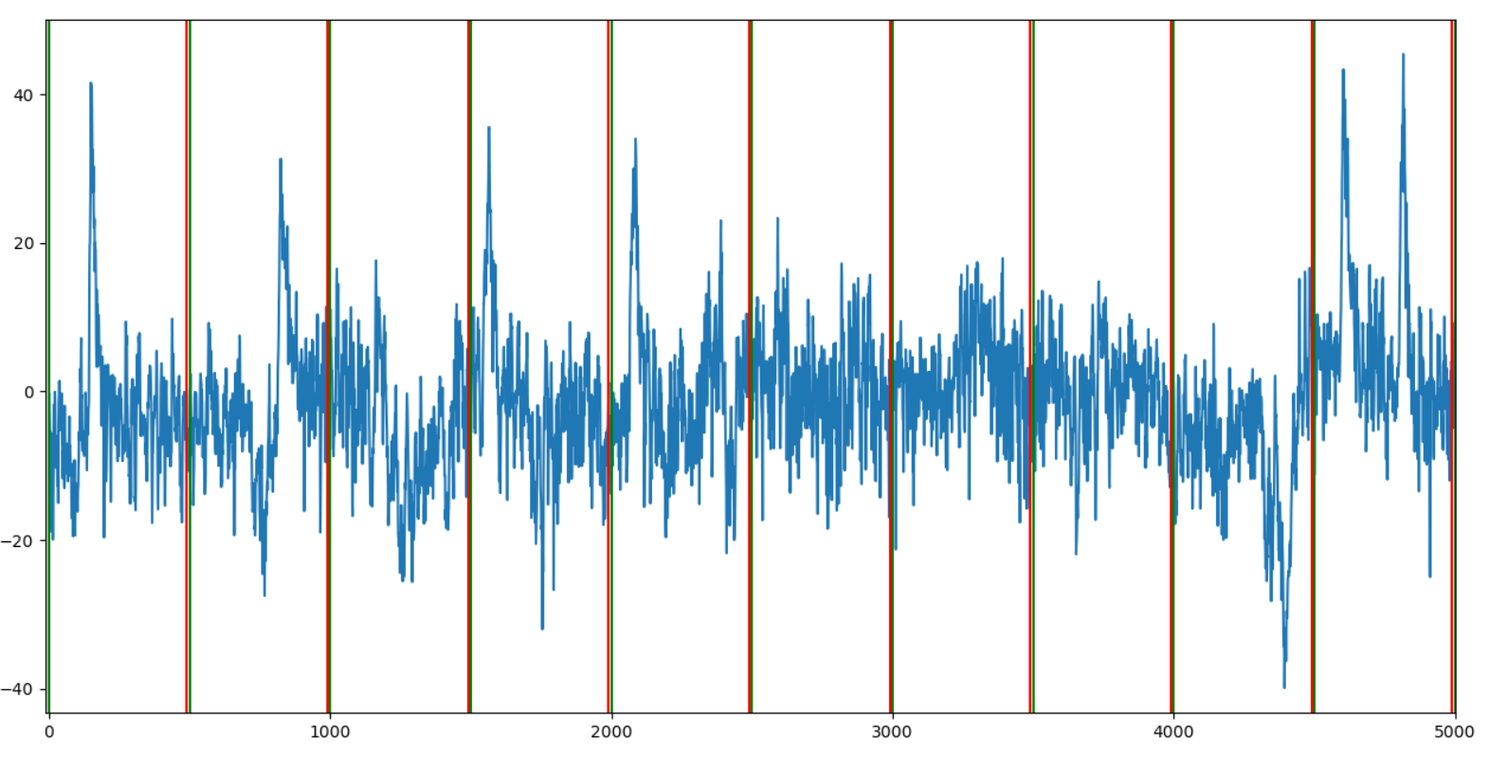
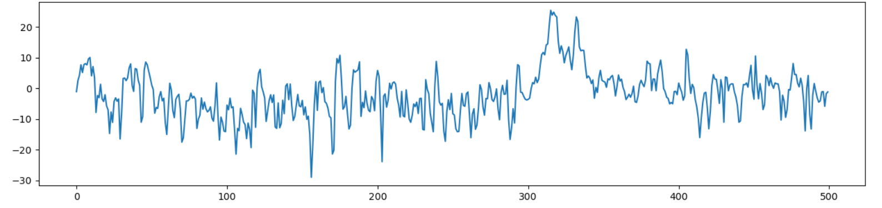
Step 2: Split into epochs
Split each subject’s raw EEG data into epochs.
Each epoch will have 500 (2.5 * 256) samples of raw eeg data.
2.5 is the epoch length in seconds
256 is the sampling rate/second
Subject#7: Epoch #118
Subject#7

Slide 11
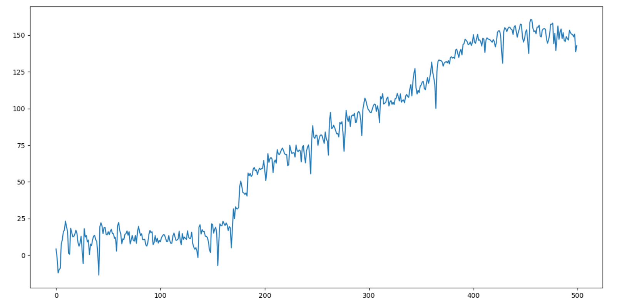
Step 3: Remove trend (1)
For each epoch, we first remove trend
1: Calculate the linear least-squares regression line on the data
y = mx + b
2: Remove trend by getting the residuals of each data point
actual value – predicted value from the linear regression line
Subject#7: Epoch #1010

Slide 12
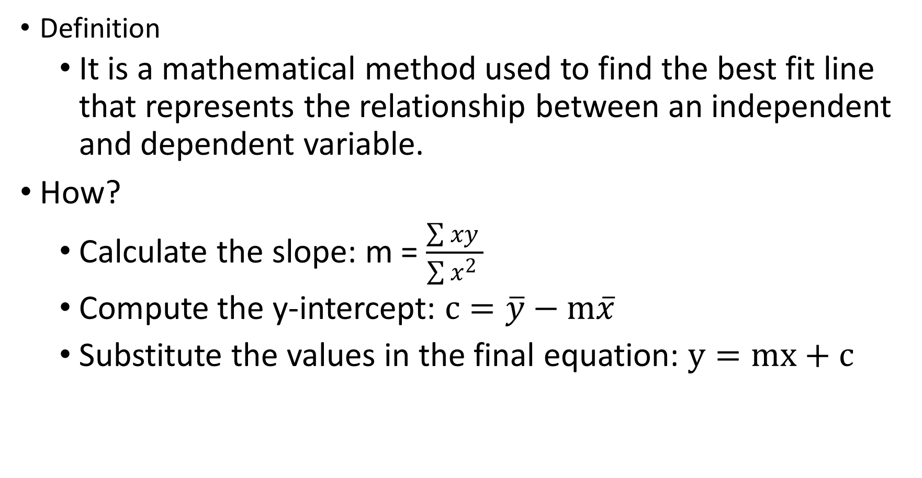
Core Concept: Least-squares regression Method
Definition
It is a mathematical method used to find the best fit line that represents the relationship between an independent and dependent variable.
How?
Calculate the slope: m = $\frac{\sum{xy} }{\sum{x^{2}} }$
Compute the y-intercept: $c=\overline{y}−m\overline{x}$
Substitute the values in the final equation: $y=mx+c$

Slide 13
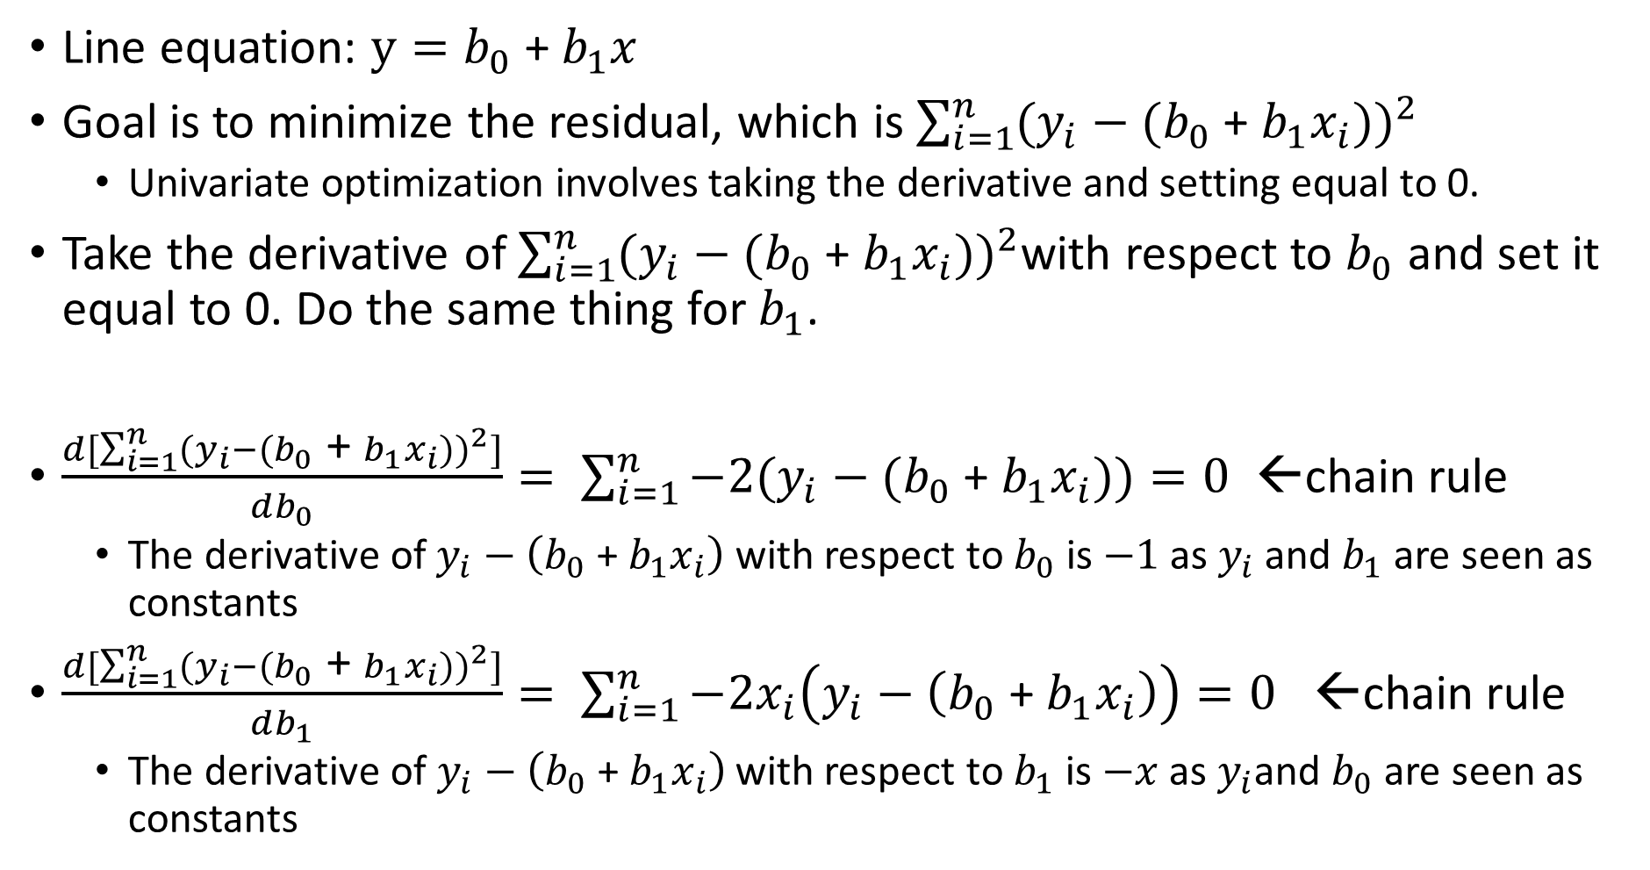
Derivation of the slope estimator of LSRL (1)
Line equation: $y=b_{0}$ + $b_{1}x$
Goal is to minimize the residual, which is $\sum_{i=1}^{n}{{(y_{i}−(b_{0}\text{ + }b_{1}x_{i}))}^{2}}$
Univariate optimization involves taking the derivative and setting equal to 0.
Take the derivative of $\sum_{i=1}^{n}{{(y_{i}−(b_{0}\text{ + }b_{1}x_{i}))}^{2}}$with respect to $b_{0}$ and set it equal to 0. Do the same thing for $b_{1}$.
$\frac{d[\sum_{i=1}^{n}{{(y_{i}−(b_{0}\text{ + }b_{1}x_{i}))}^{2}]}}{db_{0}}= \sum_{i=1}^{n}{−2(y_{i}−(b_{0}\text{ + }b_{1}x_{i}))}=0$ ←chain rule
The derivative of$y_{i}−\left(b_{0}\text{ + }b_{1}x_{i}\right)$ with respect to $b_{0}$ is $−1$ as $y_{i}$ and $b_{1}$ are seen as constants
$\frac{d[\sum_{i=1}^{n}{{(y_{i}−(b_{0}\text{ + }b_{1}x_{i}))}^{2}]}}{db_{1}}= \sum_{i=1}^{n}{−2x_{i}\left(y_{i}−\left(b_{0}\text{ + }b_{1}x_{i}\right)\right)=0}$ ←chain rule
The derivative of $y_{i}−\left(b_{0}\text{ + }b_{1}x_{i}\right)$ with respect to $b_{1}$ is $−x$ as $y_{i}$and $b_{0}$ are seen as constants

Slide 14
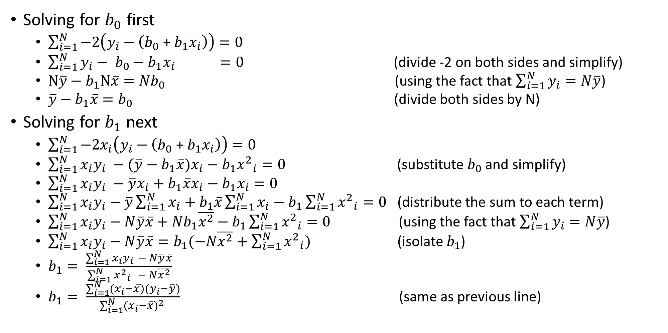
Derivation of the slope estimator of LSRL (2)
Solving for $b_{0}$ first
$\sum_{i=1}^{N}{−2\left(y_{i}−\left(b_{0}\text{ + }b_{1}x_{i}\right)\right)}=0$
$\sum_{i=1}^{N}{{y_{i}− b}_{0}−b_{1}x_{i }} =0$ (divide -2 on both sides and simplify)
$N\overline{y}−b_{1}N\overline{x}={Nb}_{0}$ (using the fact that $\sum_{i=1}^{N}{y_{i}}=N\overline{y}$)
$\overline{y}−b_{1}\overline{x}=b_{0}$ (divide both sides by N)
Solving for $b_{1}$ next
$\sum_{i=1}^{N}{−2x_{i}\left(y_{i}−\left(b_{0}\text{ + }b_{1}x_{i}\right)\right)}=0$
$\sum_{i=1}^{N}{x_{i}y_{i} −(\overline{y}−b_{1}\overline{x})x_{i}}−b_{1}{x^{2}}_{i}=0$ (substitute $b_{0}$ and simplify)
$\sum_{i=1}^{N}{x_{i}y_{i} −\overline{y}x_{i}+b_{1}\overline{x}x_{i}}−b_{1}x_{i}=0$
$\sum_{i=1}^{N}{x_{i}y_{i}}−\overline{y}\sum_{i=1}^{N}{x_{i}}+b_{1}\overline{x}\sum_{i=1}^{N}{x_{i}}−b_{1}\sum_{i=1}^{N}{{x^{2}}_{i}}=0$ (distribute the sum to each term)
$\sum_{i=1}^{N}{x_{i}y_{i}}−N\overline{y}\overline{x}+Nb_{1}\overline{x^{2}}−b_{1}\sum_{i=1}^{N}{{x^{2}}_{i}}=0$ (using the fact that $\sum_{i=1}^{N}{y_{i}}=N\overline{y}$)
$\sum_{i=1}^{N}{x_{i}y_{i}}−N\overline{y}\overline{x}=b_{1}(−N\overline{x^{2}}+\sum_{i=1}^{N}{{x^{2}}_{i}})$ (isolate $b_{1}$)
$b_{1}= \frac{\sum_{i=1}^{N}{x_{i}y_{i}} − N\overline{y}\overline{x}}{\sum_{i=1}^{N}{{x^{2}}_{i}} − N\overline{x^{2}}}$
$b_{1}= \frac{\sum_{i=1}^{N}{(x_{i}−\overline{x})(y_{i}−\overline{y})}}{\sum_{i=1}^{N}{{(x_{i}−\overline{x})}^{2}} }$ (same as previous line)

Slide 15
How I use it in artifact removal?
LSRL allows us to fit a best line within the data, which gives us the trend.
To make sure that we do not remove any good epochs that have biased std because of the trend, I will remove the trend.
By removing the trend, we will be able to more accurately compare the std of the epoch to the threshold that is being used to determine whether or not an epoch is an artifact

Slide 16
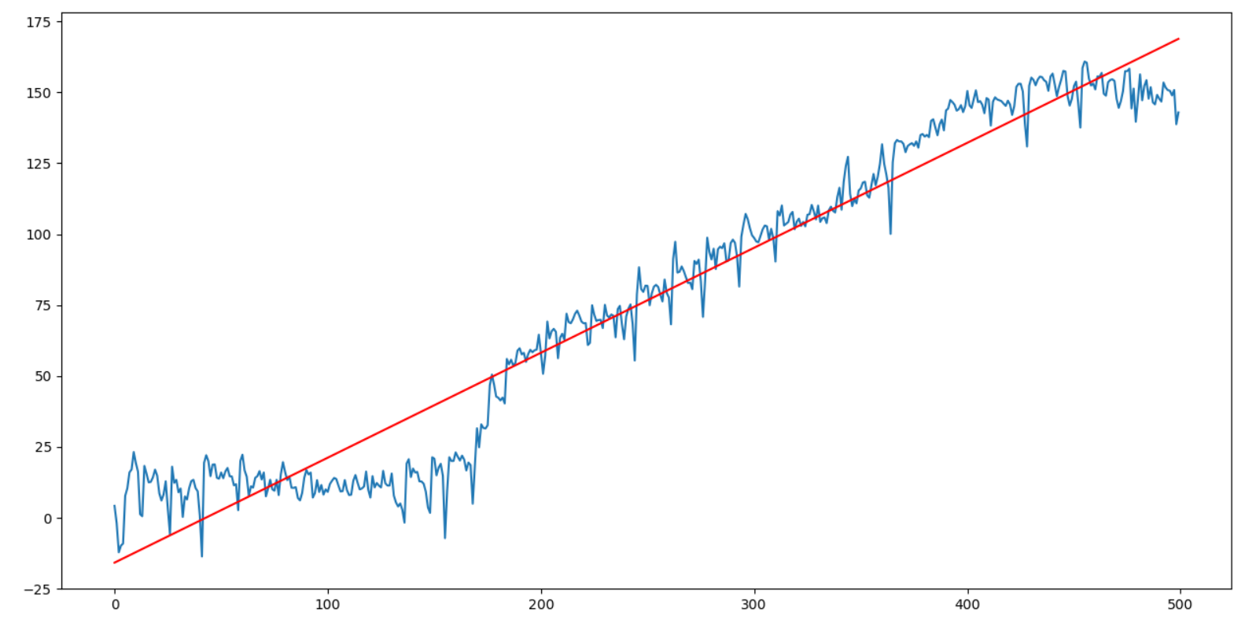
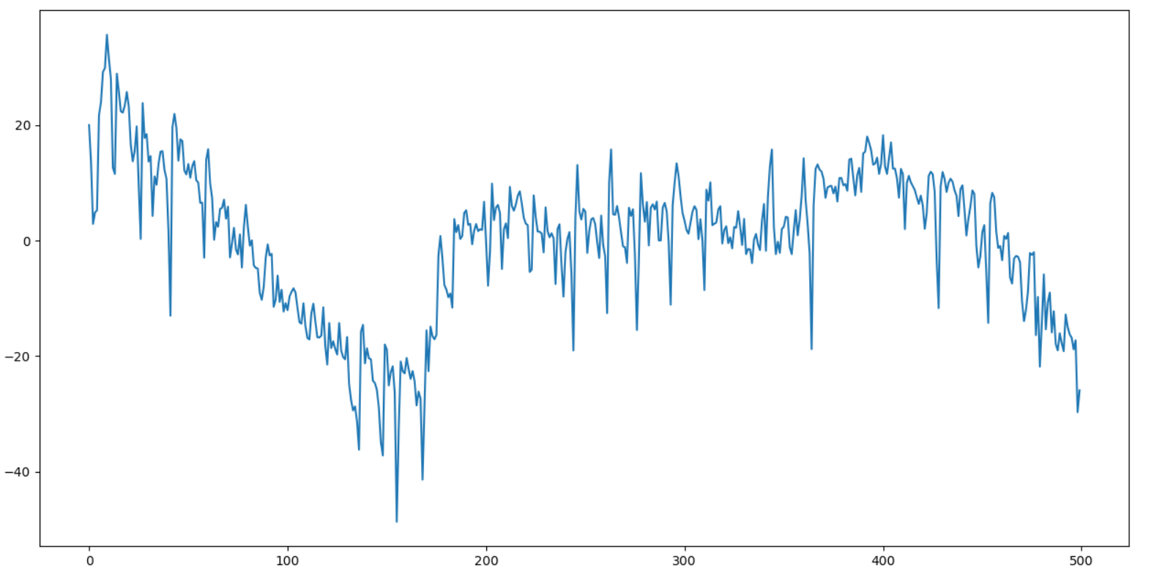
Step 3: Remove trend (2)
1: Calculate the linear least-squares regression line on the data
y = 0.37x -15.8
2: Remove trend by getting the residuals of each data point
(actual value) – (predicted value from the linear regression line)
Before removing trend PREDICATED as an artifact
After removing trend
PREDICTED as NOT an Artifact
Subject#7: Epoch #1010

Slide 17
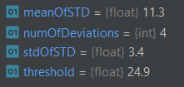
Step 4: Get Threshold
1: For one subject, calculate the std of each epoch from the good segment
2: Take all the stds from the good segment for one subject and get the mean of the stds (meanOfStds) and the std of the stds (stdOfStds)
3: Multiply the stdOfStds by 3 (number of deviations)
4: Add the value from 3 by the meanOfStds to get the threshold.
Threshold = meanOfStds + (stdOfStds*3)
The threshold will be how we will decide whether an epoch contains artifacts or not because if any value above the threshold is an outlier
5: Repeat 1-4 for every subject

Slide 18
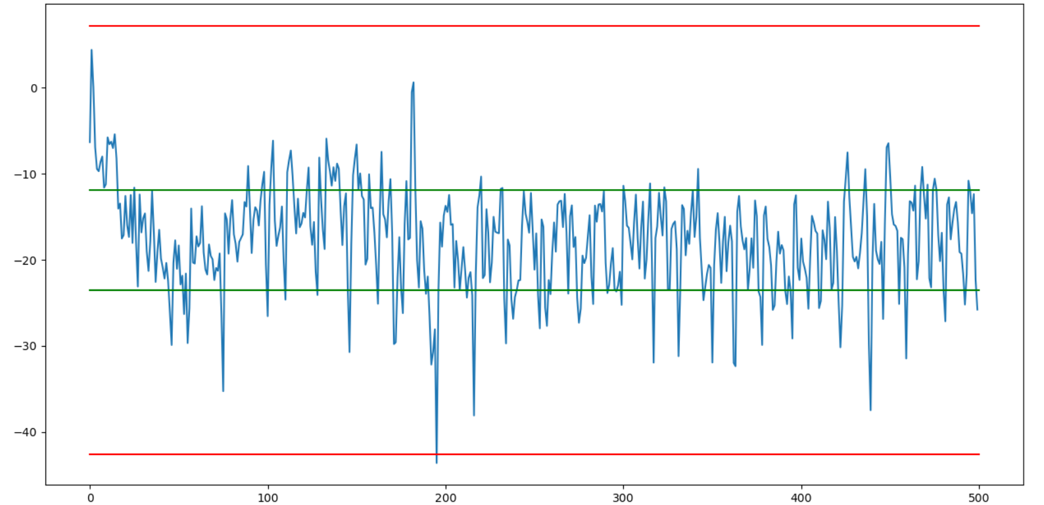
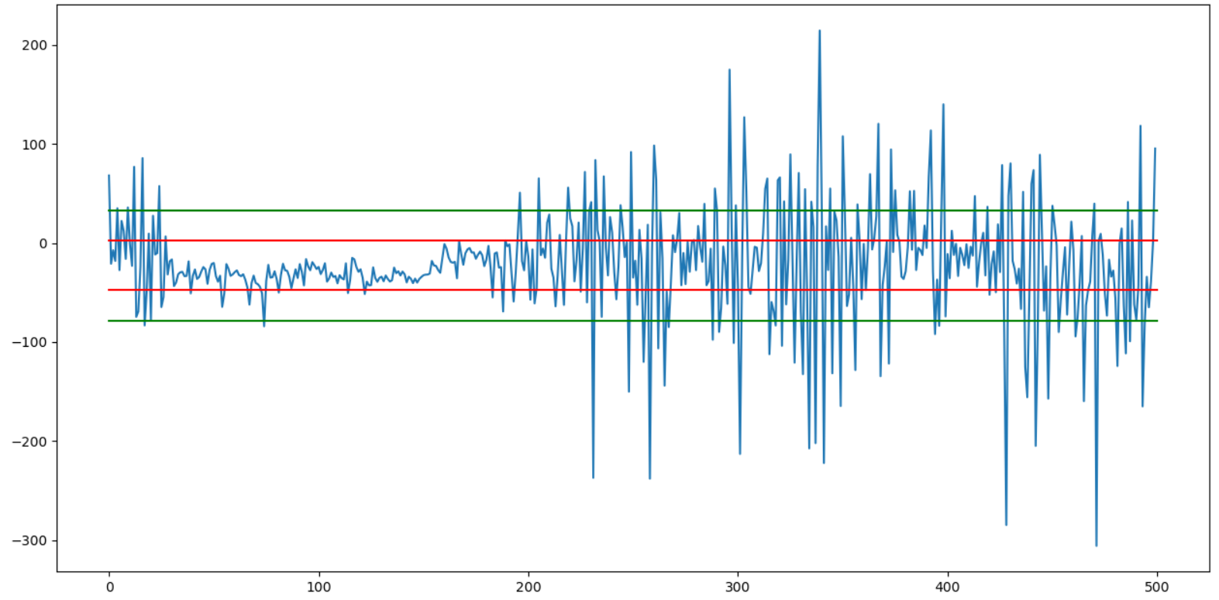
Step 5: Part 1 of the Algorithm for deciding if an epoch contains artifacts
1: Get the std of the epoch
2: If the std of the epoch is greater than the threshold, then the epoch contains artifacts
Subject#7: Epoch #1
Subject#7: Epoch #58
Green lines are the std of the epoch. Red lines are the threshold lines
If green in red (bad); if green out red (good)

Slide 19
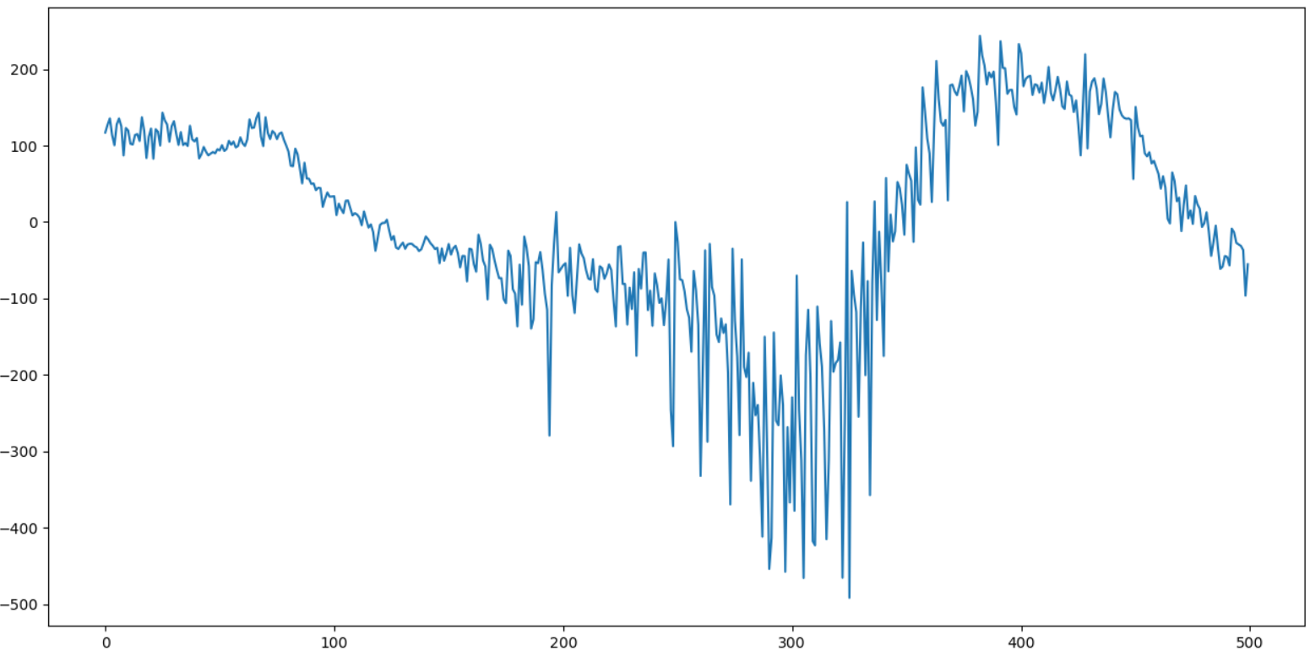
Step 6: Part 2 of the Algorithm for deciding if an epoch contains artifacts
1: Get the maximumValue
Plot all the eeg data for all the subjects, and manually decide what would be a value where any values beyond is an artifact
2: If the maximum value of the absolute value of the epoch is greater than the maximumValue, then the epoch contains artifacts
Subject #16 : Epoch #524

Slide 20
Summary for the Artifact Removing Algorithm
Step #1: Manually getting good epoch indexes
1: For each subject, plot its data and manually get the indexes of a good segment of data
Step #2: Split into epochs
1: Split each subject’s raw EEG data into epochs.
Each epoch will have 500 (2.5 * 256) samples of raw eeg data.
Step #3: Remove trend
1: For each epoch, we first remove trend
Calculate the linear least-squares regression line on the data
2: Remove trend by getting the residuals of each data point
actual value – predicted value from the linear regression line
Step #4: Get Threshold
1: For one subject, calculate the std of each epoch from the good segment
2: Take all the stds from the good segment and get the mean of the stds (meanOfStds) and the std of the stds (stdOfStds)
3: Multiply the stdOfStds by 3 (number of deviations)
4: Add the value from 3 by the meanOfStds to get the threshold.
Threshold = meanOfStds + (stdOfStds*3)
5: Repeat 1-4 for every subject
Step #5: Part 1 of the Algorithm for deciding if an epoch contains artifacts
1: Get the std of the epoch
2: If epoch_std > threshold, then the epoch contains artifacts
Step #6: Part 2 of the Algorithm for deciding if an epoch contains artifacts
1: Get the maximumValue
2: If np.max(abs(epoch)) > maximumValue, then the epoch contains artifacts

